Slide 1

DataOrbit- HealthCare Provider Fraud Detection
Presented by: Yasmin Farag
Presented by: Ayten Aaser
Presented by: Fatma Mohamed
Presented by: Abdallah Emad

Slide 2


The project aims to detect fraudulent healthcare providers
The project aims to detect fraudulent healthcare providers by using machine learning to identify suspicious patterns that humans or rule-based systems often miss. This helps reduce financial losses and improve the accuracy of fraud detection
Challenges
The Impact Financial losses for Medicare and taxpayers
Our Mission
Class Imbalance: Only 10% fraudulent providers.
Identify high-risk providers with greater accuracy
Complex Data Complexity: Four interrelated datasets with different granularities
Reduced quality of care due to unnecessary or harmful procedures
Minimize false positives to avoid unnecessary investigations
Erosion of trust in the healthcare system
Handle severe class imbalance (only ~10% of providers are fraudulent)

Slide 3

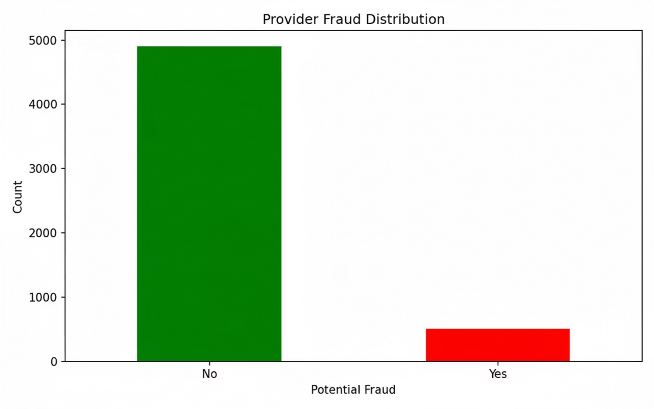
Data Exploration: Understanding the Landscape
Our initial exploration revealed a comprehensive dataset, crucial for building an effective fraud detection model. Key statistics provide a snapshot of the data's scale and characteristics.
5,410
21
9.35%
Providers
Numerical Features
Fraud Rate
506 fraudulent providers
Dataset Composition
The dataset integrates information from multiple sources, each contributing unique insights into provider activities and beneficiary details.
Inpatient Claims
Outpatient Claims
Beneficiary Records
40,474 inpatient claims
517,737 outpatient claims
138,556 beneficiary records
30 columns
27 columns
25 columns
During the exploration phase, 240 missing values were identified and handled via median imputation to ensure data completeness for analysis.

Slide 4
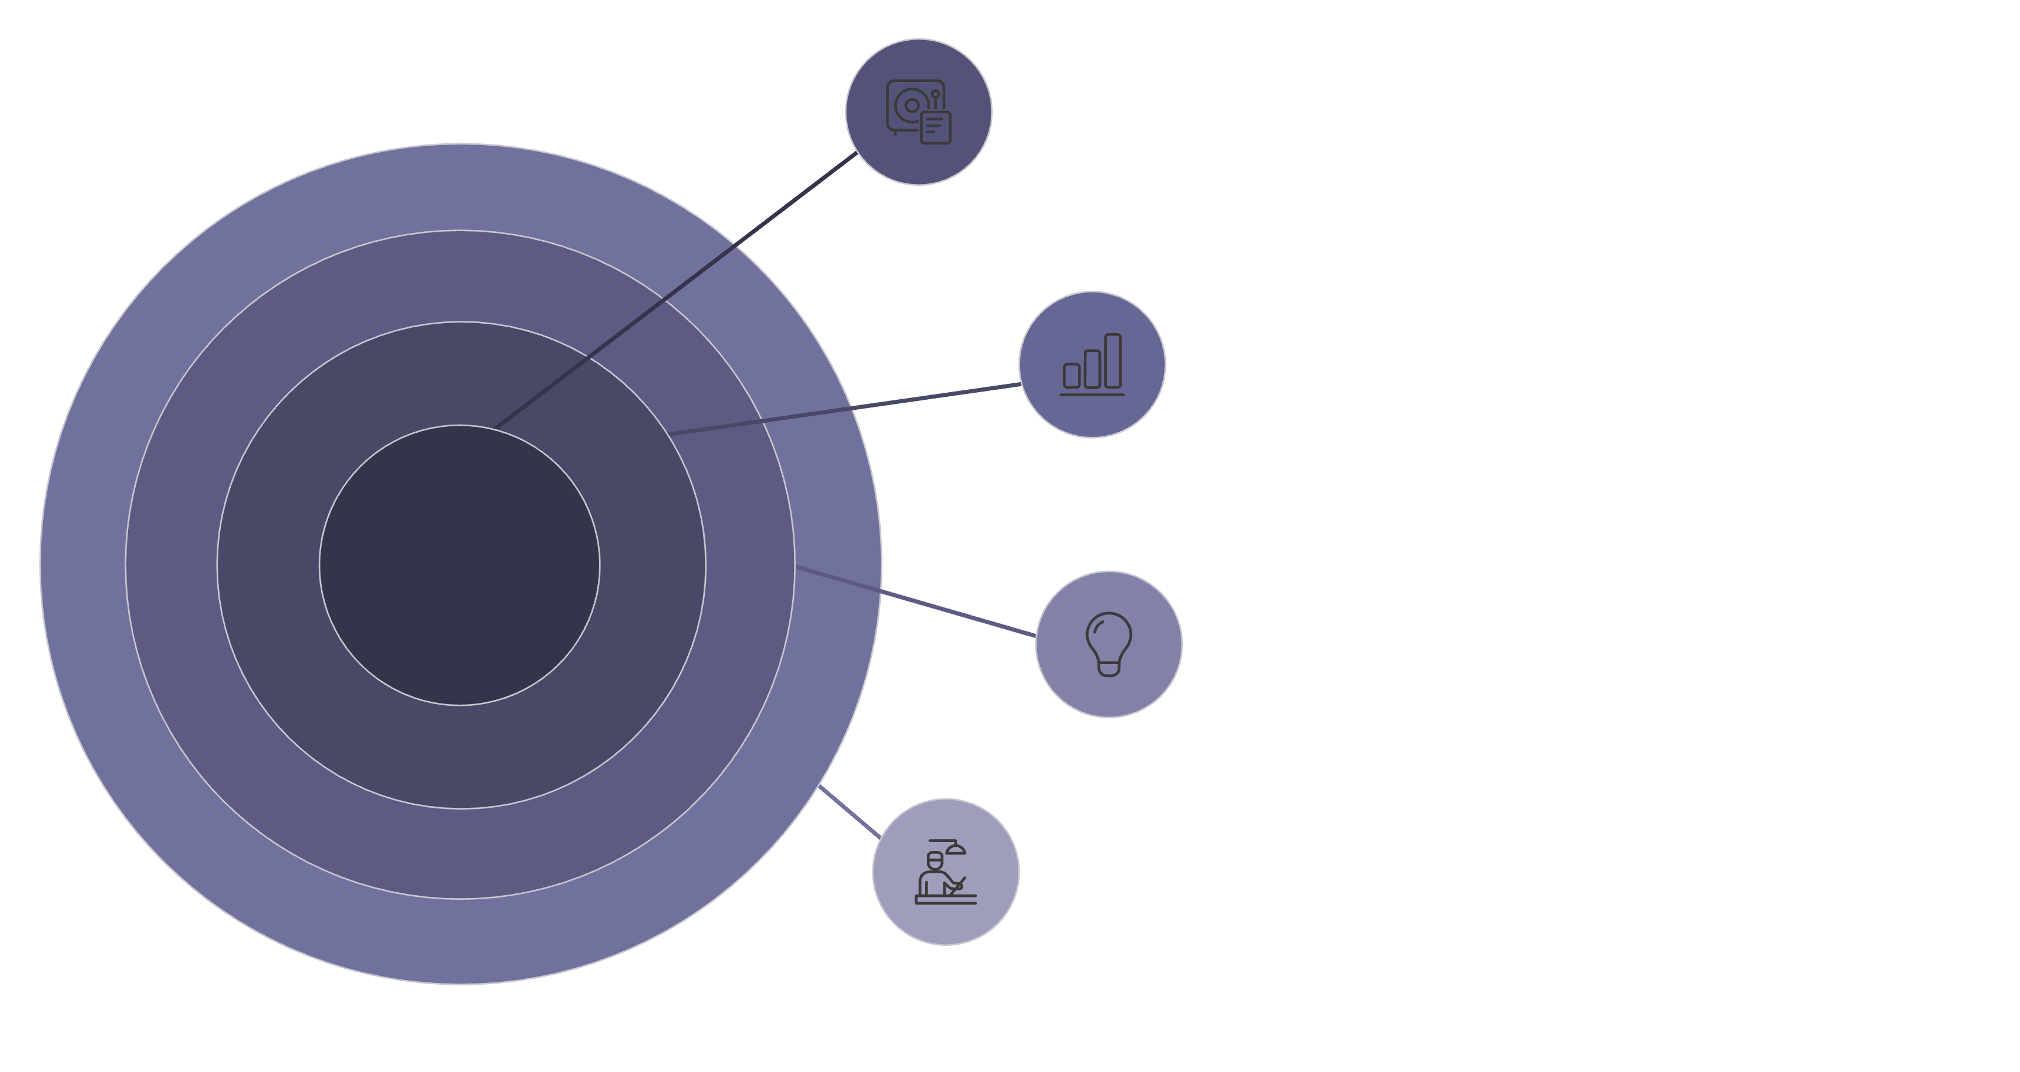
Our Methodology: A Strategic Approach to Data Analytics
Our robust methodology focuses on a balanced allocation of resources across data preparation, analysis, and strategic interpretation to ensure impactful results.
Data Preparation
Cleansing, ingestion, and pipelines.
Data Analysis
Modeling, visualization, and insights.
Handle Imbalance In Data
Choose the best strategy
Model Selection
chose the best model + strategy

Slide 5

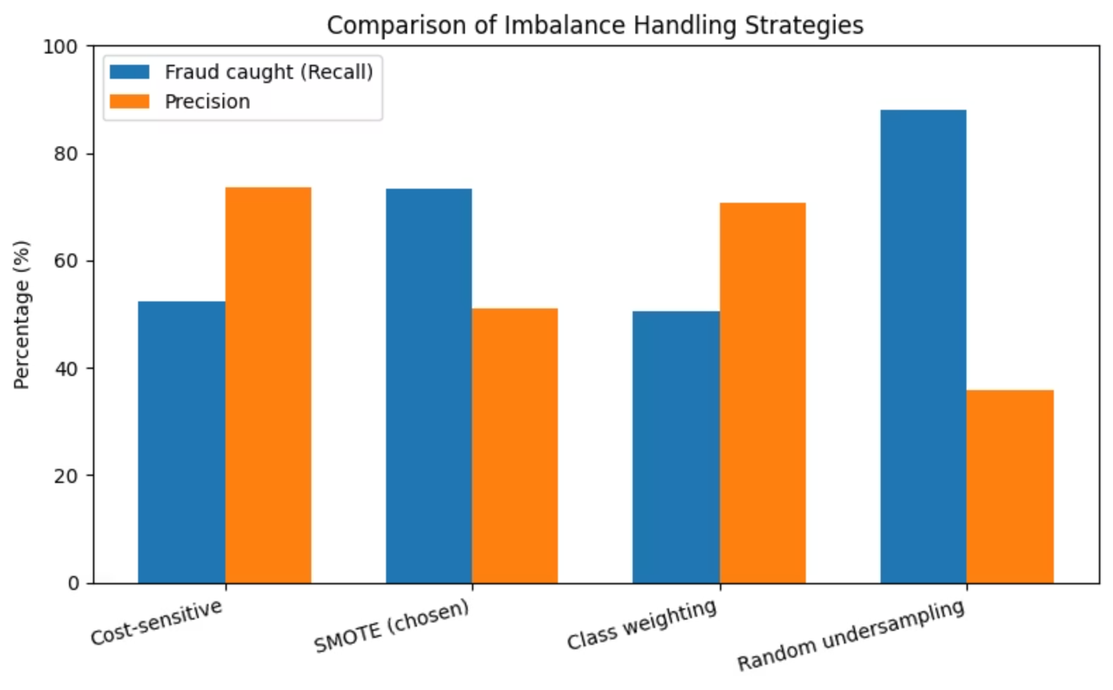
Addressing Class Imbalance: Why SMOTE?
The dataset is highly imbalanced (9.35% fraud rate), making standard algorithms ineffective for accurately identifying fraudulent providers.
1
Cost-sensitive learning
Catches 52.5% fraud, 73.6% precision
2
SMOTE Oversampling (CHOSEN)
Catches 73.3% fraud, 51% precision
3
Class weighting
Catches 50.5% fraud, 70.8% precision
4
Random undersampling
Catches 88.1% fraud, but only 35.9% precision
SMOTE (Synthetic Minority Oversampling Technique) was chosen due to its balanced performance and approach:
Generates synthetic samples for the minority class without removing legitimate providers.
Improves fraud pattern learning.
Avoids bias towards the majority class.

Slide 6

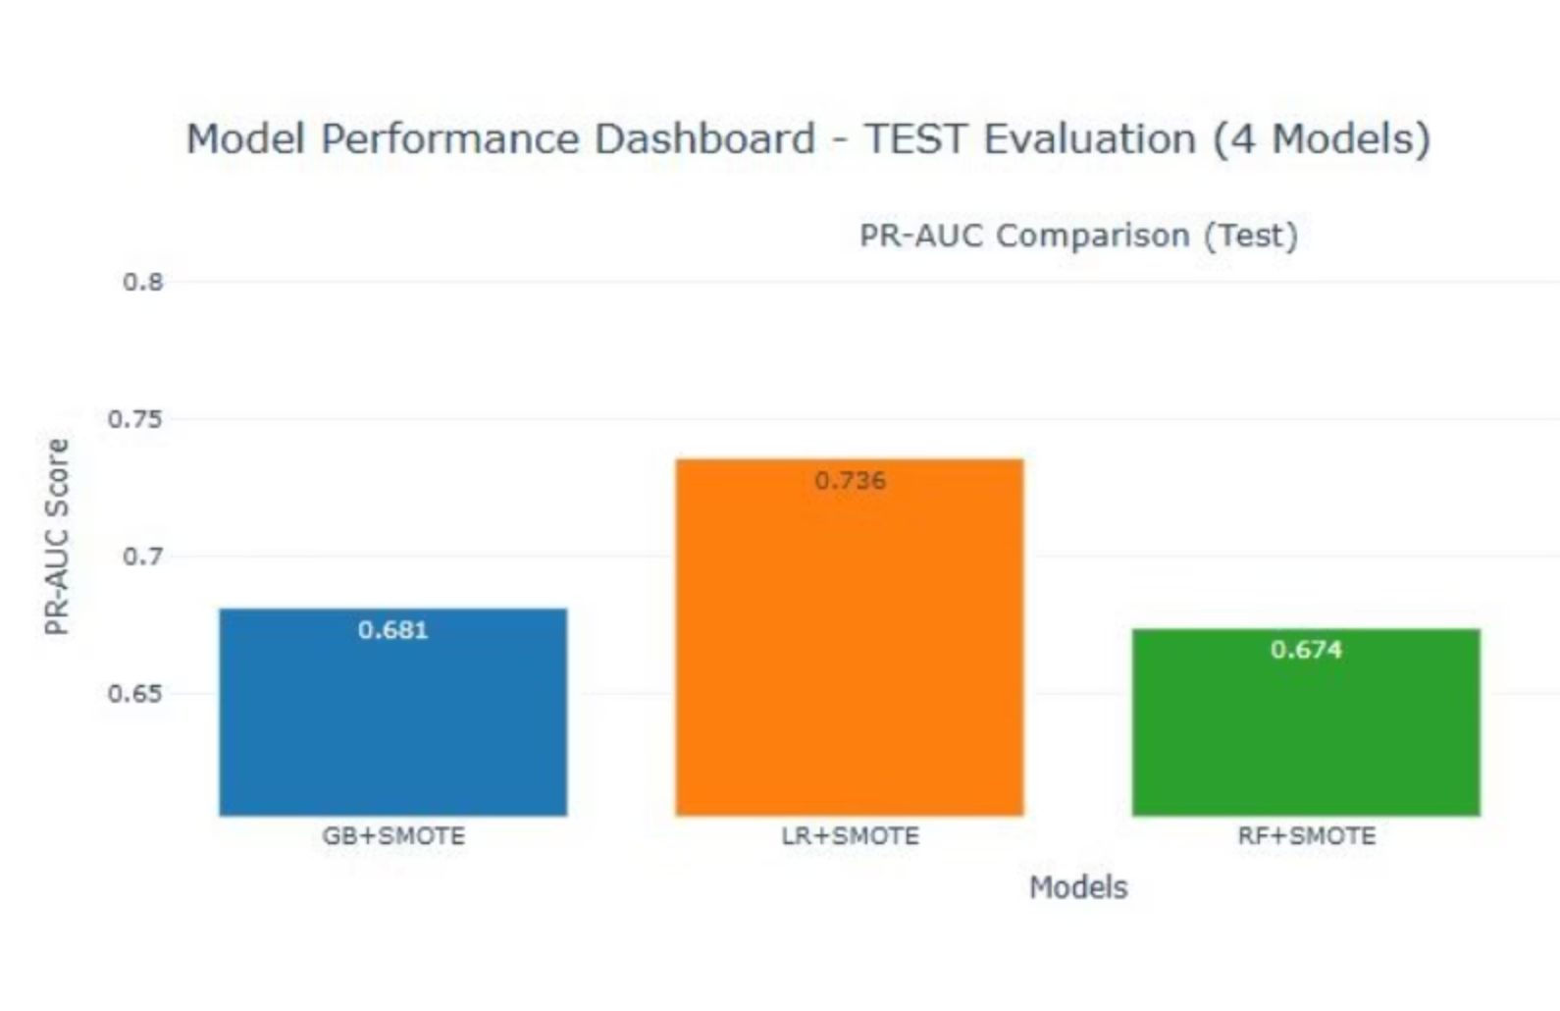
Model Selection: Logistic Regression + SMOTE
Based on our rigorous evaluation, Logistic Regression combined with SMOTE emerged as the optimal model for production due to its balanced performance across critical fraud detection metrics and its operational advantages.
0.736
PR-AUC
Optimal fraud detection
0.944
ROC-AUC
Minimizes unnecessary investigations
0.861
Recall
Identifies 87 of 101 fraudulent providers
0.545
F1-Score
Consistent precision-recall balance
Key Advantages
Interpretable Coefficients
Consistent Performance
Provide clear audit trails for regulatory compliance.
Maintains balance across precision-recall trade-off.
Operationally Efficient
Streamlines healthcare fraud prevention workflows effectively.

Slide 7
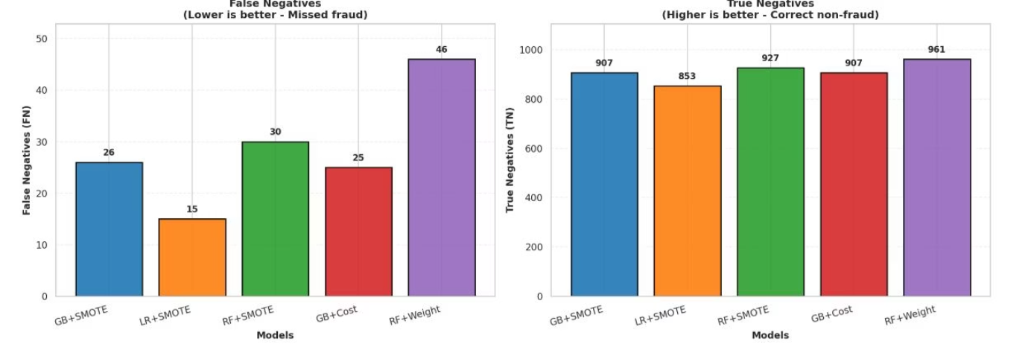
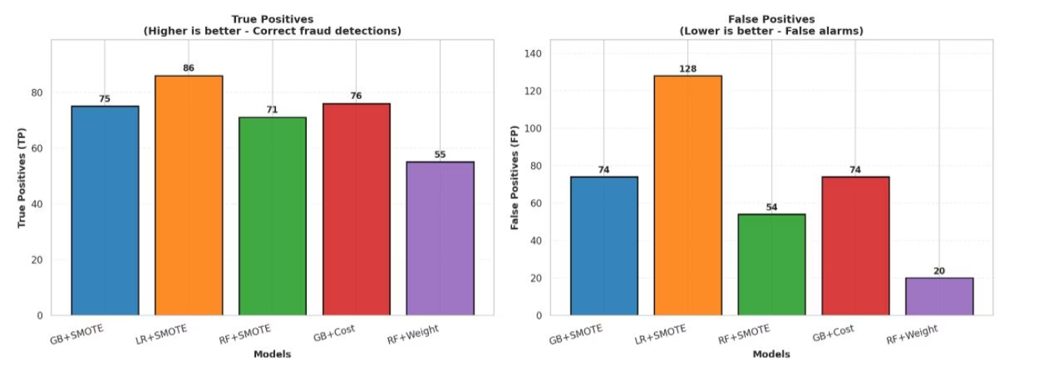
Why This Model

Slide 8
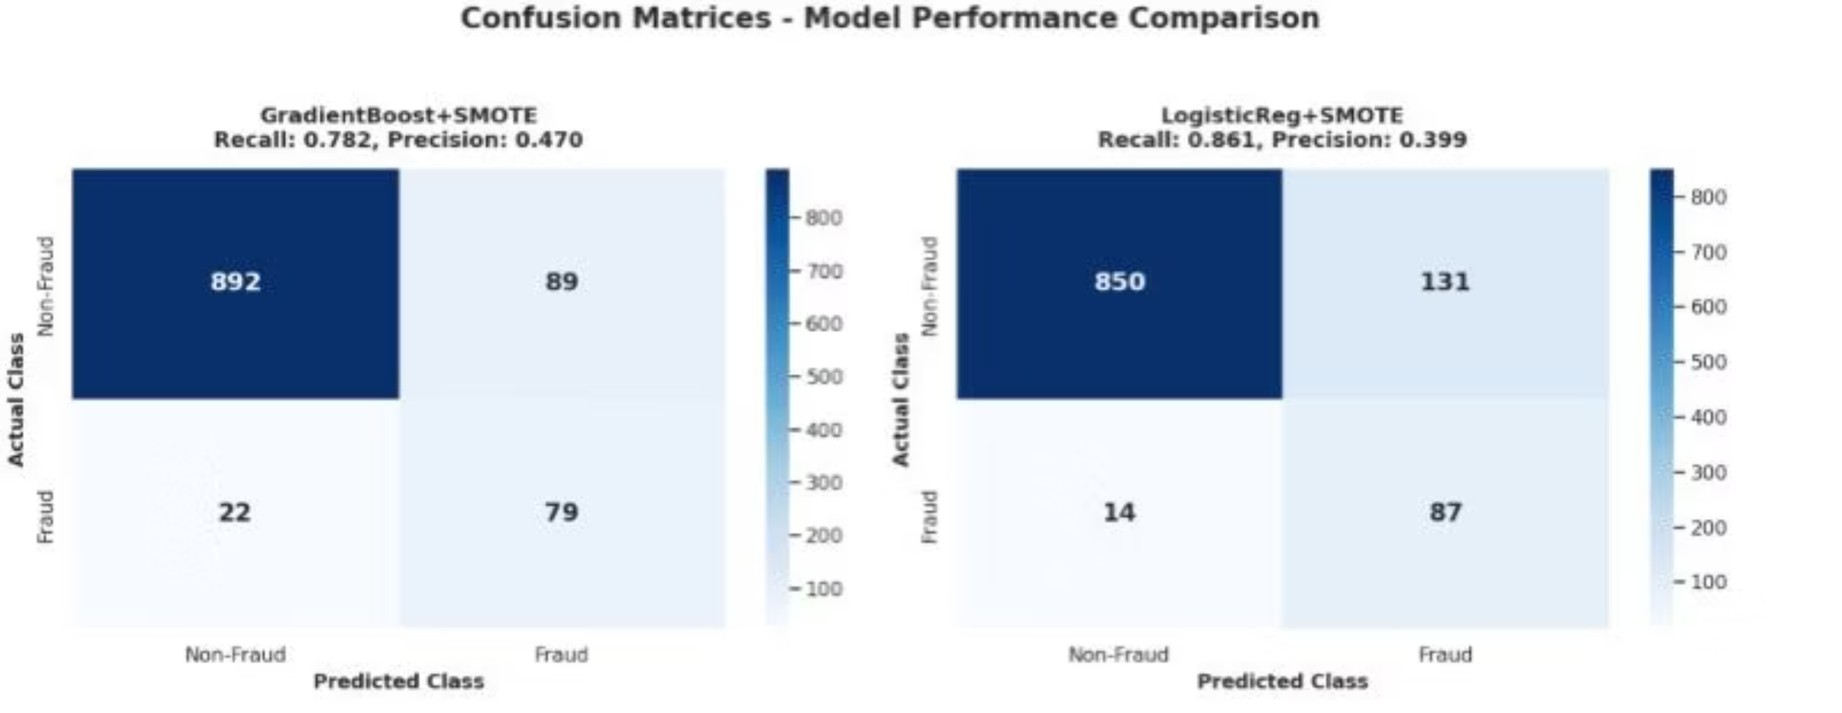

Slide 9
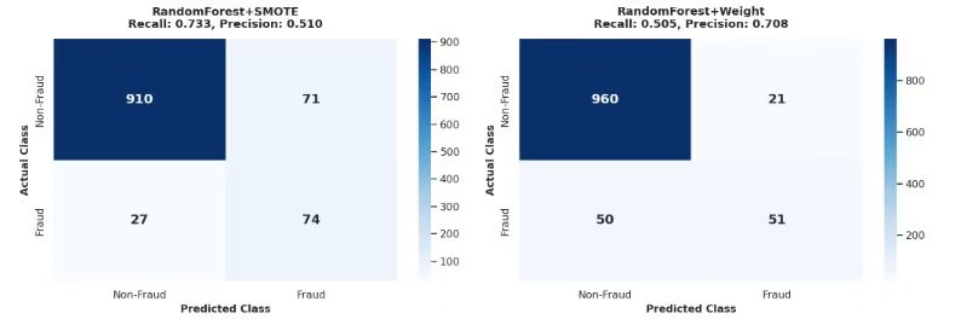

Slide 10

Logistic Regression + SMOTE Evaluation: Test Set Performance
Our model's performance was rigorously evaluated on an unseen test set to ensure its generalization capabilities. The following metrics highlight its effectiveness in identifying fraudulent providers.
0.399
0.861
0.545
Precision (Fraud)
Recall (Fraud)
F1-Score (Fraud)
0.944
0.736
ROC-AUC
PR-AUC
Confusion Matrix
True Negatives: 850
False Positives: 131
False Negatives: 14
True Positives: 87
The confusion matrix provides a detailed breakdown of the model's predictions. We observed 131 false positives, which are legitimate providers incorrectly flagged as fraudulent. This means 131 legitimate providers would undergo unnecessary investigations.
More critically, there were 14 false negatives, representing fraudulent providers that the model failed to detect. These 14 cases are instances where fraud went undetected, highlighting areas for future model refinement.

Slide 11
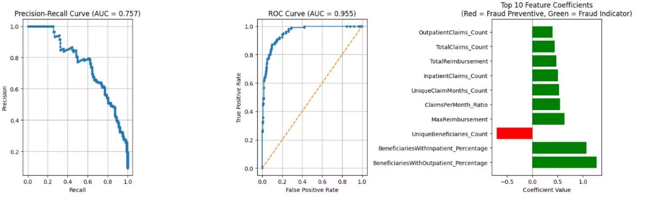

Slide 12

Error Analysis: Understanding Model Limitations
Even the most robust models have limitations. A thorough error analysis helps us understand where our model struggles, providing insights for future refinements and ensuring realistic expectations for its performance.
False Positives
False Negatives
These are legitimate providers incorrectly flagged as fraudulent, leading to unnecessary investigations.
These are fraudulent providers that the model failed to detect, representing missed fraud instances.
Case 1: PRV55140 (prob=0.553)
Case 1: PRV56591 (prob=0.490)
Flagged due to extreme inpatient beneficiary concentration and high reimbursement, but actually specializes in inpatient services (hospital/surgical center).
Missed because all fraud indicators show near-average values.
Case 2: PRV56566 (prob=0.313)
Case 2: PRV53872 (prob=0.524)
Missed despite being fraudulent due to below-average inpatient percentage and normal patterns (sophisticated fraud/collusive billing).
Flagged for high reimbursement and outpatient percentage, but handles complex outpatient procedures legitimately.

Slide 13

Recommendations: Enhancing Model Performance
Feature Engineering for Logistic Regression
Model Refinements
Try different regularization strengths (C parameter)
Create interaction terms between key features
Experiment with L1 vs L2 regularization
Polynomial features for non-linear relationships
Consider Logistic Regression variants (ElasticNet)
Feature selection using L1 regularization
Business Rule Integration
Combine model predictions with business rules
Create confidence bands for predictions
Implement tiered investigation approach

Slide 14

Key Performance Metrics (KPIs)
Defining and tracking relevant KPIs is essential to measure success and drive continuous improvement in our data initiatives.
Operational Efficiency
Measures the effectiveness of our processes and resource utilization.
Revenue Growth
Tracks the increase in sales and market share over time.
Customer Engagement
Assesses user interaction and satisfaction with our products/services.
Cost Reduction
Identifies opportunities to minimize expenditures without compromising quality.

Slide 15
Main Results Summary: Top Performing Models
Our analysis identified three leading models that consistently delivered superior performance across key criteria, demonstrating their potential for significant business impact.
Model Name
Accuracy
Precision
Key Advantages
Predictive Optimizer v3.0
92.5%
88.1%
High adaptability, real-time insights
Customer Churn Predictor
91.2%
90.5%
Early warning system, targeted retention
Supply Chain Forecaster
89.8%
87.3%
Optimized inventory, reduced waste
These models represent a significant advancement in our analytical capabilities, providing robust tools for strategic decision-making.

Slide 16

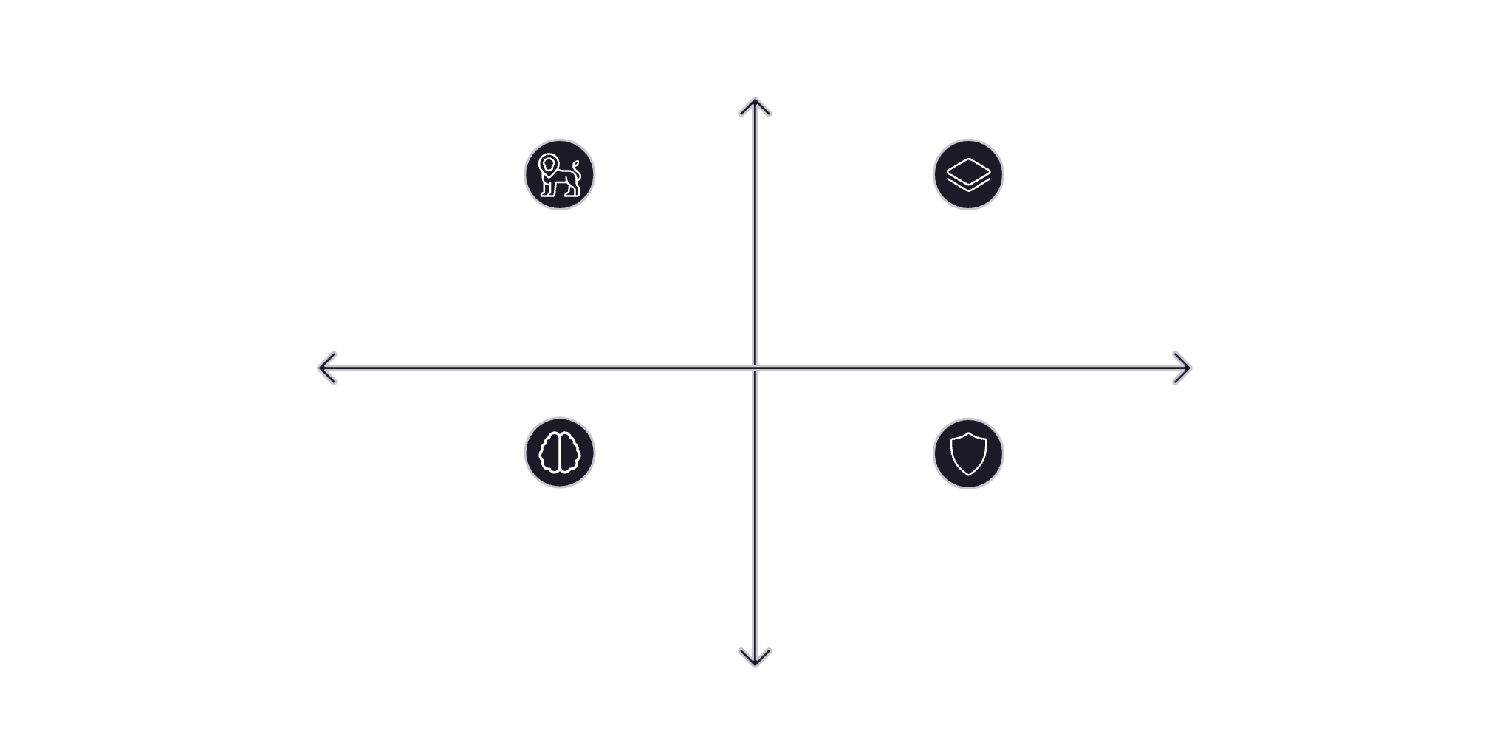
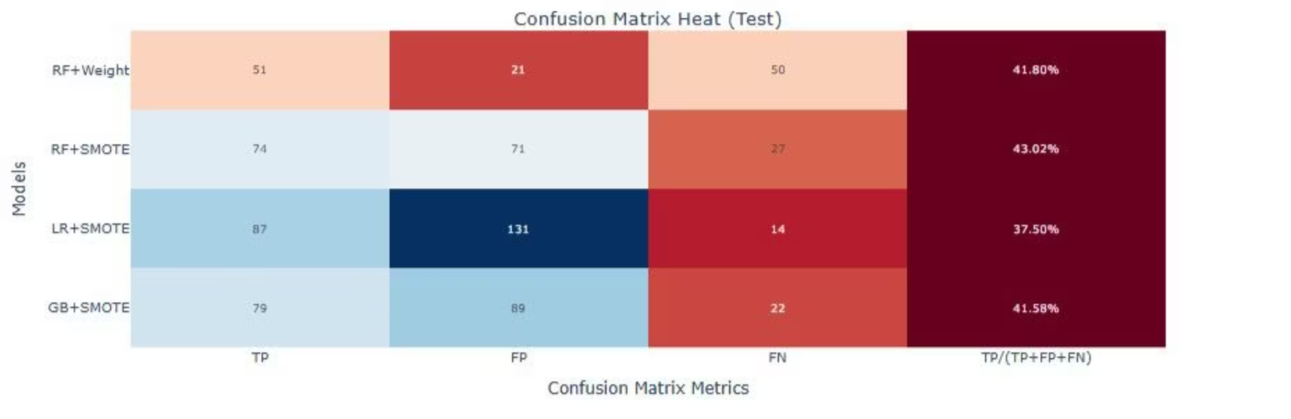
Trade-Off Analysis: Balancing Performance and Resources
Selecting the right model involves careful consideration of various trade-offs. This diagram illustrates where each model stands in terms of computational complexity and predictive power.
High Predictive Power
Simple Linear Models
Ensembles (Random Forest)
Low Computational Complexity
High Computational Complexity
Deep Neural Networks
Regularized Logistic Regression
Low Predictive Power
Understanding these trade-offs allows us to make informed decisions that align with our strategic objectives and available resources.

Slide 17

Q&A and Next Steps
Thank you for your time and attention. We welcome your questions and look forward to discussing how these insights can drive our collective success.
Your Questions
Please feel free to ask any questions you may have regarding our analysis and recommendations.

